Slide 1

Advanced Programming
Project: Quality Of Life
Students works in this project:
Khaled Al-Abdali
Omar Al-Housawi
Instructor By
Prof.Abdullah.ALzhrani
Omar Al-Quzi
Ahmad Al-Quzi

Slide 2
Three Phases In This Project
1- Drag And Drop
2-The Interfaces
3- Code Source

Slide 3
Introduction:
First of all , we developed the previous program on quality of life that was included in the algorithms course , and user interfaces are used to make work easier for users.
Now let's learn about the method we used to develop the program

Slide 4
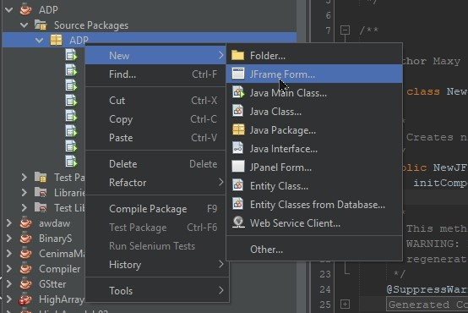
A Simple Pics for a (Drag and Drop) in Net beans
1 - To create JFrame Class In this way, JFrame is will created

Slide 5
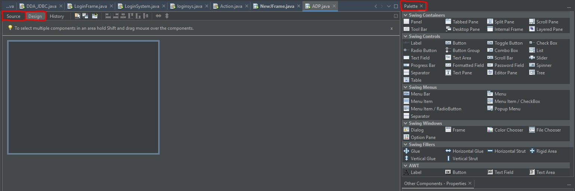
A Simple Pics for a (Drag and Drop) in Net beans
2 – Well, here this interface will appear to you , By selecting the red color you will see , ( Source ) to see your code , ( Design ) to see your Interface , and ( Palette ) to see what tools you can use like ( Checkbox , Label , Text Area , Radio Button , etc ) .

Slide 6
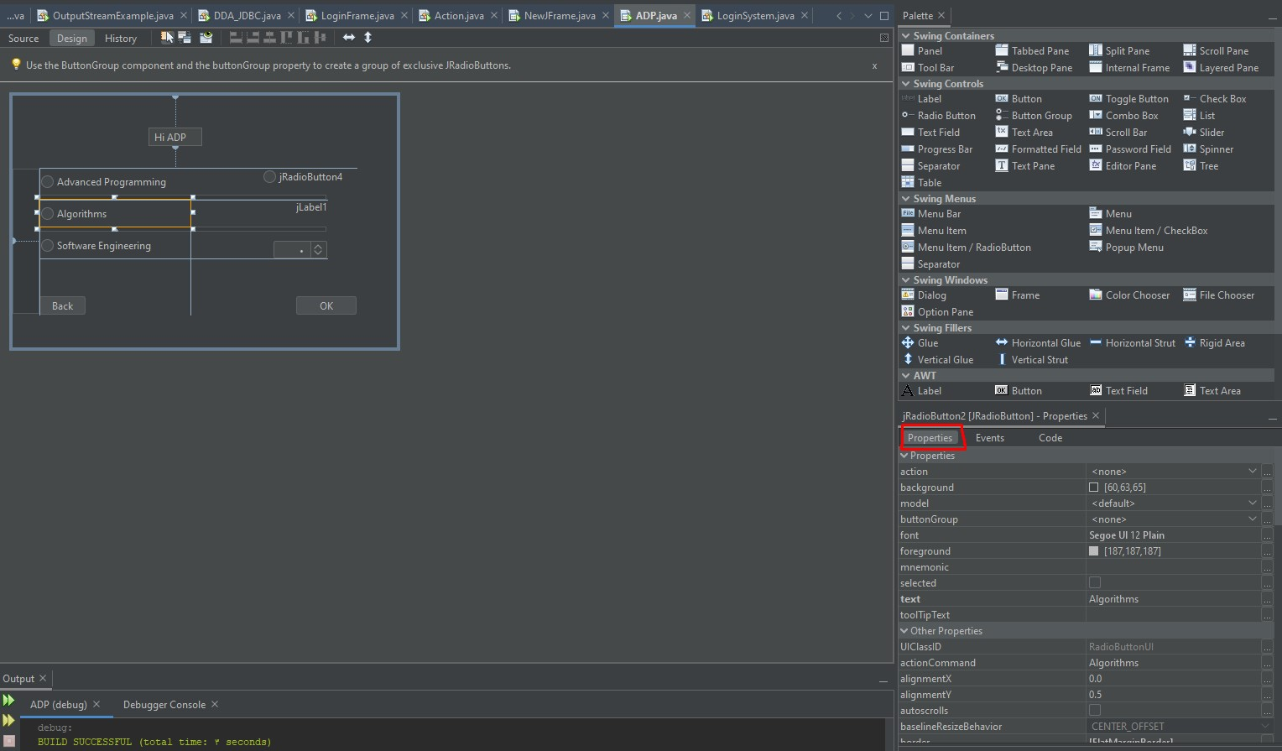
A Simple Pics for a (Drag and Drop) in Net beans
3 – Now, as we can see, this is the interface after dropping the tools in order to create an interface , in red color are the properties that you can modify on the tool you want

Slide 7
Now , that we know how Drag And Drop works we will show you our project

Slide 8
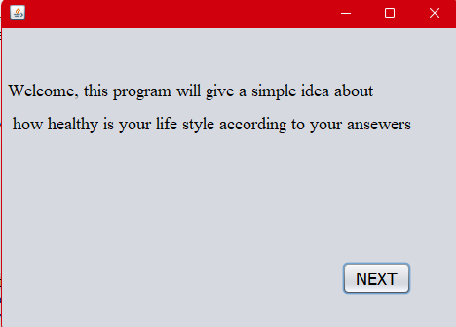
How The Program Work:
Now , that we know how Drag And Drop works we will show you our project

Slide 9
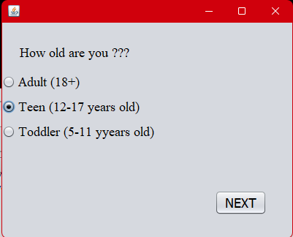
Complement. How The Program Work:
After the welcome interface, the user is given a choice of his own age group, and we have classified it into three categories:

Slide 10
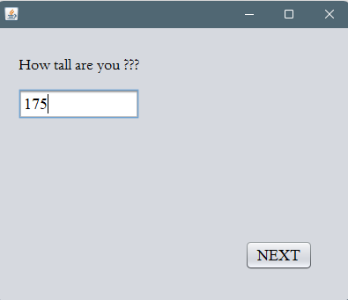
Complement. How The Program Work:
After he chooses his age group, he is asked about his height and must enter a number in the text box:

Slide 11
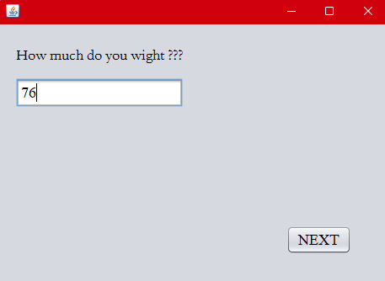
Complement. How The Program Work:
After he enters his height, he is asked about his weight and must enter a number in the text box:

Slide 12
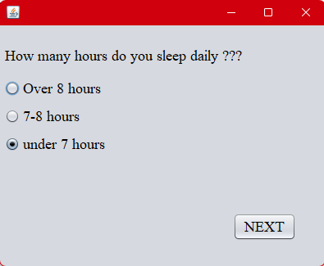
Complement. How The Program Work:
After Entering All His Information, we ask the user several questions, and he must choose one of three answers.
The first question is about sleep duration. Sleep duration was classified into three categories, and an answer must be chosen:

Slide 13
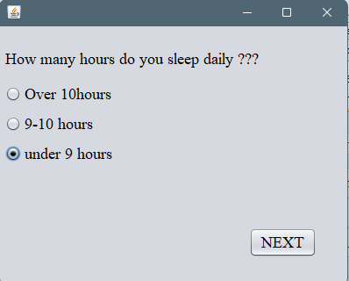
If he is a teenager, suitable options will be provided to him that suit his age:
Complement. How The Program Work:

Slide 14
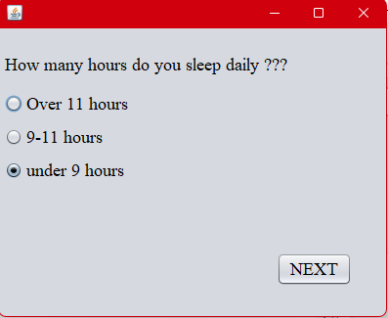
Complement. How The Program Work:
If he chooses the children's category, he will be given options according to his age:

Slide 15
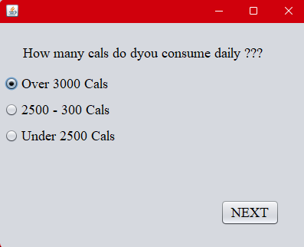
Complement. How The Program Work:
After he chooses a sleep duration, he is asked about his calorie consumption, it is classified into three categories, and one answer must be chosen:

Slide 16
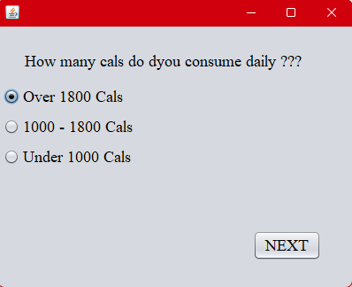
Complement. How The Program Work:
If he chooses the age group (teenager), he will be given options that suit his age:

Slide 17
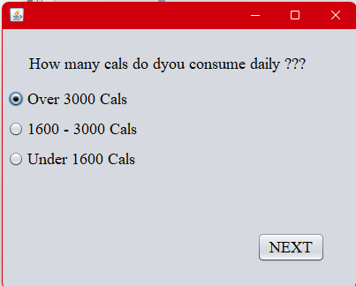
Complement. How The Program Work:
If he chooses the children's category, he will be given options according to his age:

Slide 18
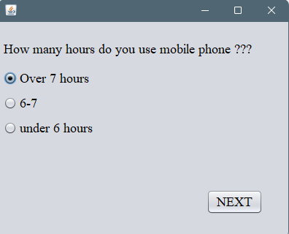
Complement. How The Program Work:
After he chooses his calories, he is asked about the number of hours he uses the mobile phone , Mobile use is classified into three categories, and he must choose an answer:

Slide 19
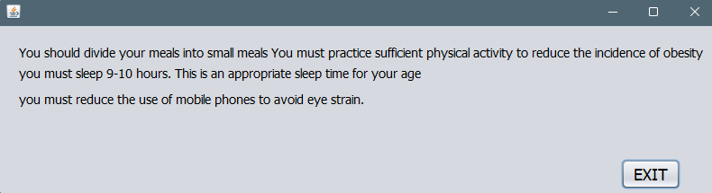
The Output Of Program:
If we assume that we include the teenager's choices in the program, this will be the final output

Slide 20
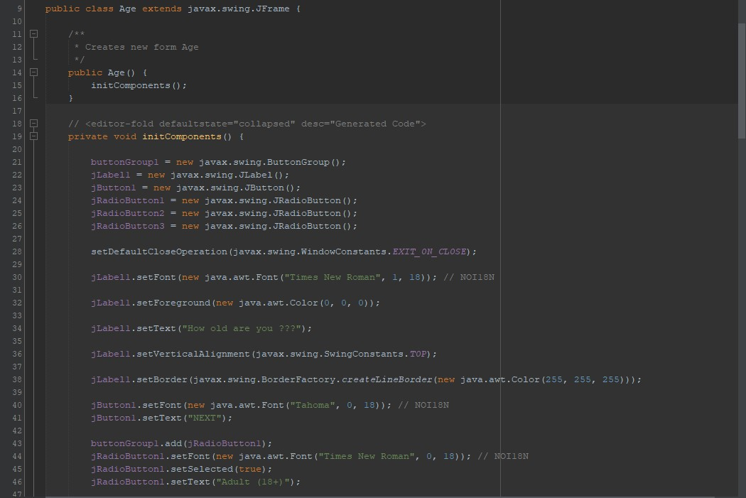
One of Source classes (Age)

Slide 21
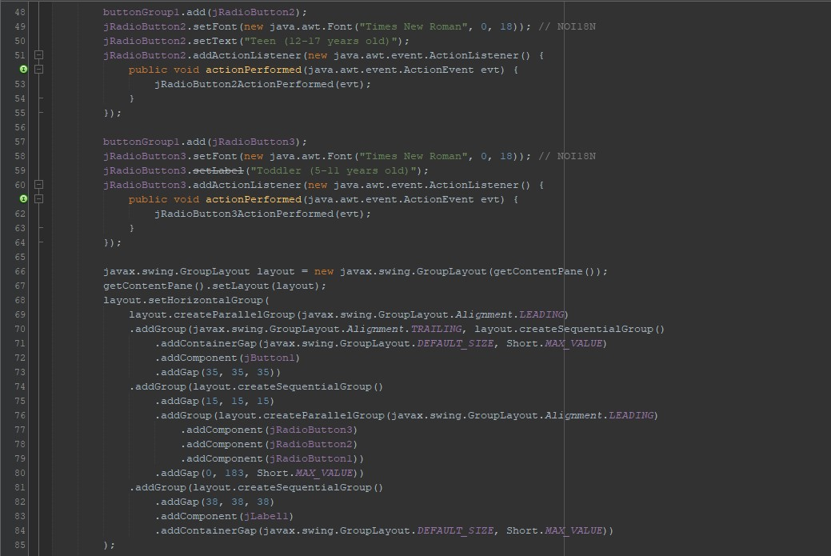
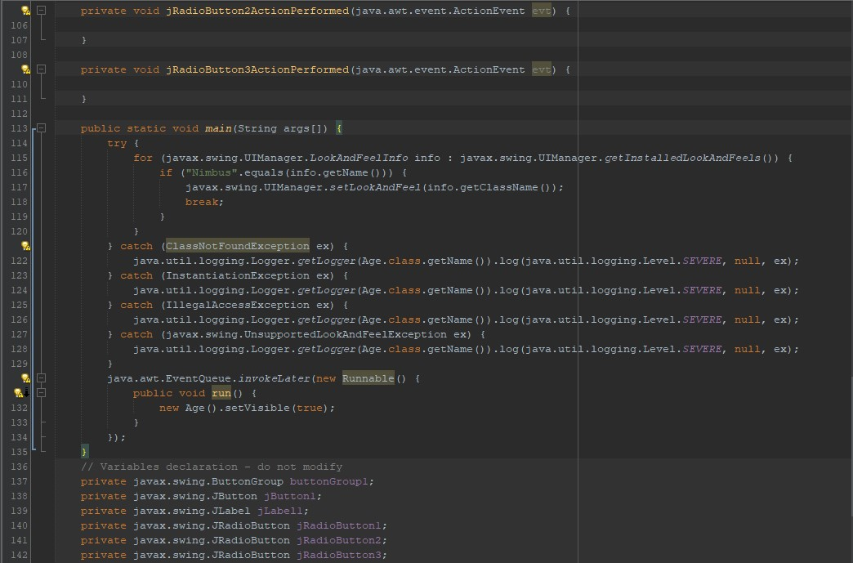
One of Source classes

Slide 22
In Conclusion:
Because we have reached the conclusion, we hope have covered this topic in all its aspects in an easy and clear way Thank You For Listening.
And thanks to Prof,Abdullah Al-Zahrani.
Greetings :
443008552
Khaled Al-Abdali
Omar Al-Housawi
443006992
Omar Al-Quzi
443003243
Ahmad Al-Quzi
442010821

